Slide 1
RE-IMAGINING SCHOOL COMMUNITIES: An Exploration of the Factors Influencing Teachers’ Trust in Parents
Joanna D. Geller
October 27, 2014
Dissertation Defense

Slide 2
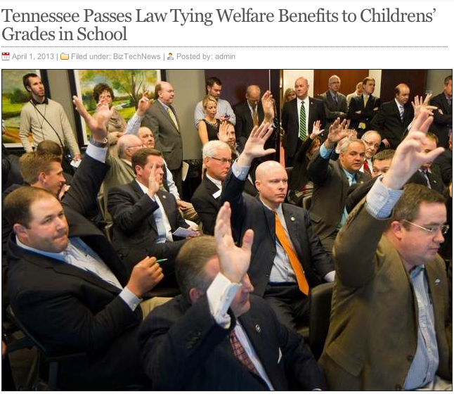
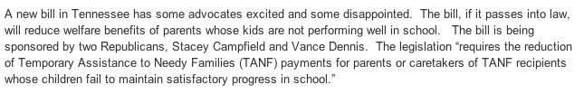
Notes:
I first want to set the stage for how discourse and media in the local context is representing low-income families and their involvement in their children’s schools. A bill was proposed in the TN state legislature last year that would…So, despite all we know about poverty influencing achievement, the white men in this room are operating under the assumption that a threat is all families need to make their children succeed.

Slide 3
We live in a society that does not trust low-income families – often families of color – to be suitable parents.
This lack of trust seeps into schools.

Slide 4
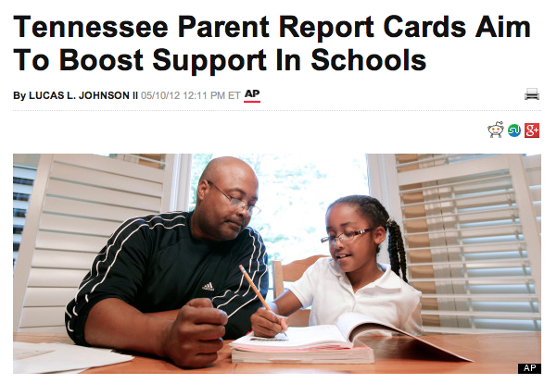

Notes:
This is a headline from the local Nashville newspaper. Parents now need to grade themselves on how involved they are, and the language here indicates that these are needed to “boost support in schools” and because “educators are exasperated” and that parent involvement won’t happen without “arm-twisting.”
This indicates a lack of teacher trust in parents.

Slide 5
Why Can’t Schools Buffer Against Mistrust?
Declining coherence between schools and communities (Merz & Furman, 1997)
Increased school choice
Increased role specialization in schools
Racial/ethnic difference: Students of color comprise 40% of the public school population. Teachers of color comprise only 17% of the teaching force (Center for American Progress, 2011)
Lack of preparation for family engagement and cultural competency (Solorzana & Yosso, 2002)

Slide 6
Defining Teacher-Parent Trust
Trust
Collective Trust
Individual-level: a teacher’s willingness to be vulnerable to a parent based on the confidence that the parent is benevolent, reliable, competent, honest, and open (Tschannen-Moran & Hoy, 2000).
Critical family engagement literature (Lareau, Lawrence-Lightfoot, 1978, 2003).
School-level: when trusting parents is a school-level norm (Forsyth, Adams, & Hoy, 2011).
Organizational literature (Bryk & Schneider, 2002; Bryk, Sebring, Allensworth, Luppescu, & Easton, 2010; Tschannen-Moran & Hoy, 2000)
Notes:
Lawrence-Lightfoot goes deep into context, such as the prominence of education in the African-American community since slavery and the ways in which both teaching and mothering are socially constructed.
So, if a new teacher were to start at the school, she would soon know from how faculty members talk about families and family engagement what the level of collective trust is in the school.
Org. literature uses quantitative data and looks at trust mostly as an independent variable, but doesn’t have that rich contextual detail. Interested in setting-level phenomena, but also interested in the contextual factors which are overlooked by the organizational literature.

Slide 7


Trust Involves…
a) interdependence
b) risk
Notes:
Not like empathy or respect where you’re not dependent on the other person. There’s a risk in trusting someone – you can get let down because you are interdependent.

Slide 8
Why Does Teacher Trust in Families Matter?
Children achieve at higher rates when parents and teachers trust one another.
Bryk et al., 2010
Goddard, Tschannen-Moran, & Hoy, 2001
WHY?
Parents and teachers instill in child common norms and values (Coleman, 1988)
Trust is a “lubricant” for effective collaboration (Bryk & Schneider, 2002).
Collective trust is associated with teachers having high expectations for students and collective teacher efficacy (Hoy, 2012).
Gap between what teachers expect from families and what families do frustrates teachers and lowers morale (Hargreaves, 2005; Nakagawa, 2000).
Notes:
Infuse conversation about interdependence and risk here.
Bullet 1: Research shows that there is reason to believe interdependence between parents and teachers is important. I trust you to discipline my child.
Bullet 2: Consider the last time you asked someone to collaborate with you. You’re more likely to collaborate and collaborate effectively if you trust that that person is well-intentioned and competent and reliable and honest and open.
Bullet 3+4: Risk in having high expectations and believing that together teachers can accomplish something. They invest time and energy into this and can be let down. Notion that family engagement is so important but it still lets you down.

Slide 9
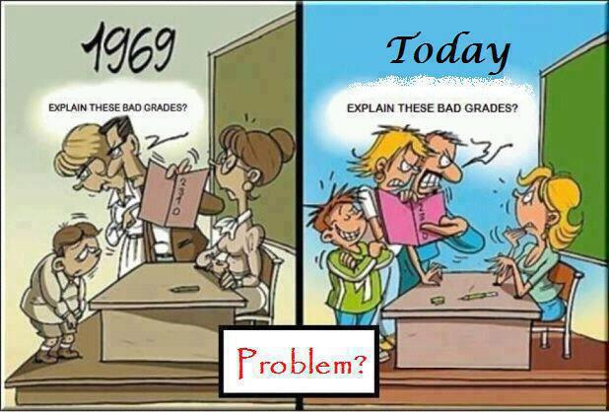

Slide 10
Schools should be sites of resistance, not of social reproduction (Bourdieu).

Slide 11
How Do Schools Develop Collective Faculty Trust in Families?
Murkiness about how faculty have agency to influence social exchange
School-level behavioral, cognitive, affective mechanisms
Internal Context
School racial and socioeconomic composition
Social Construction
External Context
Social exchanges within a group about the observed behavior of members of another group or individual
Collective comparison between expected and observed behavior evaluated in terms of trust criteria
Collective Trust
Insufficient attention to external context
Task Context
Omission of role of individuals
Forsyth, Adams, & Hoy (2011)
Notes:
Really play up how this is the first study to take an ecological approach to collective faculty trust.
Murkiness about…requires a more ecologically based model that actually considers individual faculty members and how the experiences and attitudes of individual faculty members influence social exchange between faculty.
Downplays the influence of other external factors and looks exclusively at how school-level mechanisms are influenced by external factors(including increased Gesellschaft) and overlooks how individuals are influenced by external factors and how those individuals contribute to social exchange in schools.

Slide 12
Theoretical Model: What contextual factors enable and hinder the development of collective faculty trust in families?
Notes:
Amalgamation of organizational literature and critical family engagement literature
Individual level is informed by the critical family engagement literature. We know less about how teachers converse with one another about low-income families, how they might have agency to influence the dialogue in a way that promotes collective faculty trust, and what contextual factors influence the nature of their social exchange.
How do you change individuals and social exchange at the same time? Not enough to change one or the other.
What external factors influence individual faculty trust in families?
How does social exchange between faculty influence individual teachers and how do individual teachers influence social exchange?
How does the school context influence social exchange between faculty?
How does the educational policy environment influence school context?

Slide 13



Study
Context
2011-2012
Smith Elementary
Jones Elementary
Teachers Involving Parents (TIP)
Notes:
My research took place in two schools. School B was considerably smaller than school A with about 130 fewer students. Both had student populations that were ____________. And, school B had been ‘fresh started’ in 2010, meaning that all but 3 teachers were replaced because the school was deemed as failing under NCLB. Both schools were located within a Promise Neighborhood initiative, and both were in their first year of being associated with CIS, a national community schools operator that places in schools a full-time community school coordinator. For the first year, both schools also offered a six-week in-service PD called Teachers Involving Parents (TIP) to faculty after-school, and TIP was a pre-packaged program selected by the Promise Neighborhood staff and implemented by the CIS coordinators. Teachers reflect on their definition of parent engagement, how they form opinions about parents, and how well their communication practices align with their goals for parent engagement
6 sessions, 90 minutes

Slide 14
School Sites
School | Size | % Black | % Hispanic | % FRPL | SY 11-12 change in math scores | SY 11-12 change in reading scores | % at or below basic in math | % at or below basic in reading
Smith | 358 | 86.9 | 5 | >95 | +3.2 | +5.7 | 71 | 74
Jones | 229 | 85.2 | 8.7 | >95 | -6.9 | +2.3 | 73 | 83
Notes:
Change table to reflect text

Slide 15
Methods Overview
Naturalistic Inquiry (Lincoln & Guba, 1986; Patton, 2002)
Seeks to understand a process as it unfolds
Understand a phenomenon holistically
Inquirer cannot maintain objective distance from the phenomena being studied
Observations, interviews, document analyses, survey data
Notes:
Important for looking at the influence of a pilot program where CIS coordinators were given leeway to adapt it as much as they wanted to make sure it worked optimally in their own schools
Which aligns with using ecological systems theory as one of my theoretical frameworks
Which gets to my interest in understanding how the broader context of community schools and PN, but also the broader policy environment which conflicts with the goals of PN and community schools, influenced collective trust
Which was important because I was so heavily involved in the operation of the program

Slide 16
Observations
Observed all 12 TIP sessions – 6 per school
Field notes described physical and social environment, planned and unplanned program activities, non-verbal communication, non-occurrences, and my own thoughts, feeling, reactions
Used list of sensitizing concepts (Patton, 2002) generated from conceptual model
Field notes shared with TIP program team; feedback sought at weekly meetings

Slide 17
Interviews
Included classroom teachers, EL teachers, special education teachers, support staff (guidance counselors, cafeteria manager, CIS coordinators)
Recruited with help from CIS coordinators
$15 Target gift card incentive
 | # of interviewees | # & % of TIP participants | # & % of classroom teachers
Smith | 18 | 10 (83%) | 12 (66%)
Jones | 15 | 6 (100%) | 13 (93%)
Notes:
Didn’t do research at Cooke; Cayce students zoned there; school was constantly in crisis mode; CIS coordinator said she asked her principal for a list of all the programs operating in the school and the principal wasn’t able to name the programs off the top of her head. So, I think discussing in the results how these factors influenced the implementation of the program is important (did one interview with CIS coordinator)
At Robertson, went with CIS coordinator to teachers during planning time to ask for an interview or had teachers I’d already interviewed introduce me to their grade team partner
At Webster, recruitment was more difficult because teachers started mentioning that they were being asked to do a lot and the CIS coordinator was understandably more protective of their time, but she did send one follow-up e-mail to the initial e-mail request, and she gave me permission to e-mail each of the TIP participants individually. So, I ended up interviewing 10 of the 12 participants, and one of the participants I didn’t interview was out on sick leave.

Slide 18
Survey data
To supplement qualitative data with statistics on school-level affective, behavioral, and cognitive mechanisms and collective faculty trust in families
Two instruments
Family engagement/school climate survey
Teaching Empowering Leading & Learning (TELL) survey
Response rates
Smith: 90% on FE/SC survey; 73% on TELL
Jones: 100% on both surveys

Slide 19
Measuring School Climate
Behavioral | Affective | Cognitive
Reflective dialogue scale (Bryk et al., 2010): “How often have you had conversations with colleagues about the goals of this school?” TELL: How much time teachers ) spend in required faculty meetings and b) engaging in collaborative planning time. | Teacher-teacher trust scale (Bryk et al., 2010): “It’s okay in this school to discuss feelings, worries, or frustrations with other teachers.” TELL: To what extent faculty believe their school is a good place to work and learn supplements this scale. | Orientation to innovation scale (Bryk et al., 2010): “In this school, teachers have a ‘can do’ attitude.” TELL: To what extent teachers a) have a role in school improvement planning, b) take steps to solve problems, and c) work outside of the school day.

Slide 20
Measuring Family Engagement
Invitations for involvement: How many times teacher has invited parents to be engaged in specific ways, such as “contacting a parent if the child does something well or improves” Hoover-Dempsey et al., 2002 | School outreach to parents: Degree to which the school reaches out to parents in a variety of ways, such as “parents are greeted warmly when they call or visit.” Bryk et al., 2010
Teacher perceptions of parent involvement: What percentage of parents have participated in activities, such as parent-teacher conferences or talking to child about his/her day Hoover-Dempsey et al., 2002 | Parent-teacher trust: Degree to which parents and teachers trusted one another, such as “Teachers at this school respect students’ parents.” Bryk et al., 2010

Slide 21
Document Analyses: TIP program documents
Weekly evaluations
Open-ended responses seeking feedback about most and least useful components of session
Final evaluation
Closed and open-ended responses seeking feedback on specific changes teachers plan to implement as a result of the program; what concepts are more understandable; and suggestions for future programming
Notecards, flipchart pages, worksheets

Slide 22
Data Analyses
Created codebook from theoretical framework
Used software (Dedoose) to conduct line-by-line open coding, revising codebook along the way
Used the constant comparative method (Boeije, 2002) to compare and contrast individual teachers and schools

Slide 23
Constant Comparative Method
Organized coded excerpts by topic (e.g. collective faculty trust; affective climate)
Examined similarities and differences within group (e.g. school), noting inconsistencies
Examined similarities and differences between group, noting inconsistencies
Triangulated with survey data, when applicable
Notes:
The constant comparative method offers an inductive approach to categorizing, delineating and connecting data (Boeije, 2002). I selected this analytic method, because throughout data collection and coding, I observed meaningful differences between the two schools and between teachers’ attitudes and behaviors related to family engagement. Exploring similarities and differences between Smith and Jones and between individual teachers enabled identifying salient themes within a similar group and comparing these themes to the themes that emerged in different groups. In addition to enabling identification of themes, fidelity to the constant comparative method also requires identifying the range of commonalities and differences within similar groups (Boeije, 2002), a step that prevents the researcher from over-generalizing.
I loosely followed a step-by-step process detailed by Boeije (2002). Table 4 depicts the data sources on which I relied and my step-by-step analytic method for each of the pertinent comparisons and relationships I cover. Although the specific steps varied by topic, using the constant comparative method involved first organizing excerpts from relevant codes into like categories (e.g. school); then identifying themes that were common within the like category (e.g. within school); and finally, identifying how common themes within the like category differed from common themes in another category (e.g. between schools). For each topic, I also created memos to note any inconsistencies within the same transcript or within a like group in order to avoid over-generalizations.

Slide 24
MIRRORS OF SOCIETY: HOW EXTERNAL FACTORS INFLUENCE INDIVIDUAL FACULTY TRUST IN FAMILIES
How did trust in families differ between teachers who described their interactions with families as positive and effective (P/E); negative and ineffective (N/I); and some of both (M)?
What factors account for these differences in trust?

Slide 25
The nature of teacher interactions with families varied by school
5
4
4
1
7
6
6
11
10

Slide 26
Varying levels of trust in parents motivated teachers’ interactions with parents.

Slide 27
Negative/Ineffective
Degree of trust:
Parents are not benevolent, competent, reliable, honest, or open. This is because of cultural deficiencies.
Behavior:
Change the parents.
“So we, well, I, my goal is just to get the parents talking to the kids, because they don't really talk to their kids. They yell at them, but they don't really talk about, you know how a lot of parents will say to their kid, oh, I'm putting on your right shoe, and I'm tying your shoelaces, and they talking about what they're doing. These parents don't do that.”

Slide 28
Medium
Degree of trust:
Parents are not benevolent, competent, reliable, honest, or open. There are structural reasons for this.
Behavior:
Change the parents. But, build a relationship first.
“And I called the parent and I’m like, ‘Look, I need your support; I can’t do this on my own. I need you to ask him, ‘Do you have homework tonight?’ And she hung up on me. Why? Because homework was no big deal to her, but if, if I had met with her, maybe, face to face, or did a home visit or something, and we had tried to like make some kind of connection, you know, it’s easy to hang up to a voice on the phone, but if we had a relationship, you know, maybe that would not have happened.”
Notes:
Came from a teacher who constantly talked about how apathetic parents were and said that parents weren’t naturally apathetic but they were more concerned with making sure the lgihts stayed on.

Slide 29
Positive/Effective
Degree of trust:
Parents are benevolent, competent, reliable, honest, and open.
Behavior:
Taking the time to develop a true relationship will pay off, even if I have make myself vulnerable.
“One thing I’ve, I try to use humor. I try to show my own inadequacies. I try to let them know that, yes, it’s hard…But there’s a few phrases I’ll say. ‘You're not alone.’ ‘If you need to hear of another experience let me know.’ I truly, and I’ll make sure I’ve made eye contact, and I’ll look at them and I’ll go, ‘I need you to hear me when I say this, I truly know where you're coming from.’ And then I’ll wait, I’ll just give it a second.”

Slide 30
1. Hegemonic norms about family engagement and low-income families influenced teachers’ trust
Notes:
They just don't know, you know, they're, they don't get the socioeconomic, they don't understand the barriers or the obstacles. And that, the argument that I've heard so many times in this building over and over again is you're successful because you made good choices. Well, it's more than that. Those choices were available to me, and our kids don't, haven't had as many choices available to them. So, you know, I don't think that there is a lot of understanding about that.

Slide 31
Teachers in the N/I group defined family engagement in a traditional sense.
“Unfortunately, I wouldn’t say that family engagement is very high at this school. We definitely would like, as teachers, way more support than we do. We don’t have a lot of parents that show up for parent-teacher conferences, PTO meetings, or even meetings that we may call. A lot of times, a lot of parents do not volunteer. A lot of it is mostly on us.”

Slide 32
Teachers in the N/I group made frequent references to the culture of poverty.
“But it's heartbreaking, to say the least. But I wish the parents would take the initiative to get involved in what's going on in their child's life. I mean, you're, and a lot of our parents do not work. They don't work, so what hinders you from getting up out of your bed a couple of hours, or whatever you do, and just come volunteer?”
“There’s just a, it’s just a different culture. Inner city, it’s just a different world here, you know.”

Slide 33
Teachers in the Medium group vacillated between structural and cultural explanations for low family engagement.
“A lot of our parents don’t take advantage of that [the online report card], partially probably ‘cause they don’t have the technology at home, they may not know how, they may not, whatever. But, I have parents are saying, ‘Well, what are my kid’s grades?’ ‘Well, get on Grade Speed.’ They're not making themselves aware of some of those things like that, but then they wanna get their report card and get all upset. ‘You think you could look at your kid’s grades at any time all year long. District policy.’”

Slide 34
Teachers in the P/E group did not conflate structural challenges with cultural deficiencies.
“Well, one of the strengths that I think I've seen time and time and time again with my families here is that I have never ever, ever met a parent or a family member that did not want better for their child, ever. Regardless of their situations, I have had parents on drugs, I have had parents in prison, I have had parents that were prostitutes, and in spite of those extreme challenges, they have always wanted more and better…And so for me, that has always been a good place to start.”

Slide 35
2. Teachers’ emotions from interacting with families influenced trust

Slide 36
Differences in Emotions
N/I group: Sadness | M group: Frustration | P/E group: Willingness to be vulnerable
Little spirits dwindle quote | “Sometimes I find myself being focused on the problem and not the solution. Like, I’m so frustrated I can't get so-and-so’s mom to sign anything, to come down here, to respond to my phone calls. That instead of being how can I get her to do it? I’m just, grrrr!” | “This is a parent who’s actually very active. And that’s what people didn’t pay attention to. Anything the school needed. Anything we did in the classroom. This parent would make sure you had it. The parents are just a little rough around the edges. And I didn’t, you know, count her off and just say, uh uh, I’m not dealing with it.”
Notes:
These feelings come out of love for the children and care and concern over their well-being. All teachers said they’re a parent, a nurse, a social worker.

Slide 37
3. The educational policy environment influenced teachers’ trust
Notes:
The state holds so much against teachers, principals, everybody within the school. I feel like there needs to be some type of standards for parents. Cause it’s almost like nobody ever says, okay, well what did the parent do? You know, it always comes back on our environment, teachers, principals. I think that the parents should be held accountable, too. And there isn’t any mandated policy that addresses that issue. Cause our parents are missing in action. That’s how we got here in the first place…There should be some type of extreme consequence if you are not involved in your child’s education. And there isn’t.
“Children develop at all different stages. And you’re telling me that my kid isn’t proficient by second grade and learn to read at this level, blah, blah, blah, then they’re going to fail. I mean that’s disheartening and it’s inappropriate.”

Slide 38
How so?
Less time to develop relationships with families due to emphasis on standardized testing
Difficult at Jones to develop trust with families because of school turnaround
Parents’ lack of interest in learning about standardized testing affirmed lack of teacher trust
Emphasis on teacher accountability was projected onto parents

Slide 39
Teachers in the N/I group projected language of accountability onto parents.
“The state holds so much against teachers, principals, everybody within the school. I feel like there needs to be some type of standards for parents. Cause it’s almost like nobody ever says, okay, well what did the parent do? You know, it always comes back on our environment, teachers, principals. I think that the parents should be held accountable, too. And there isn’t any mandated policy that addresses that issue. Cause our parents are missing in action. That’s how we got here in the first place…There should be some type of extreme consequence if you are not involved in your child’s education. And there isn’t.”
Notes:
Consistent with Merz and Furman’s (1997) assessment of teachers’ confusion with the paradoxical mission of schools to build community and efficiency, teachers condemned the over-emphasis on testing but wished for parents to care about it more, sensing that it was unfair that they were held accountable, while parents were not. Framed this way, family engagement was destined to result in disappointment (Auerbach & Collier, 2012; Evans, 2011; Henry, 1996; Nakagawa, 2001; Rogers, 2006).

Slide 40
SETTING THE STAGE: COLLECTIVE FACULTY TRUST AND SCHOOL BEHAVIORAL, AFFECTIVE, AND COGNITIVE MECHANISMS
To what extent did collective faculty trust in families exist in each school?
What was the nature of faculty social exchange regarding family engagement?
What are the similarities and differences between the schools’ affective, cognitive, and behavioral climates?

Slide 41
Perceptions of Collective Faculty Trust Varied Dramatically
Teachers in the P/E group (70%) remarked that colleagues constantly expressed mistrust in families.
Correlations from survey data show that the more a teacher believes there is collective faculty trust:
The less effort she makes to engage parents
The less she believes parents are involved
The more she believes the school does to reach out to parents
Notes:
Teachers could have been describing completely different schools
Collective faculty trust scale was really just measuring teachers’ perceptions, not the setting.

Slide 42
What Were The Consequences of Faculty Social Exchange?
Lowered expectations of first-year teachers for family engagement.
“And they [colleagues] were like, ‘Your parents aren’t gonna show up today.’ And I was like, ‘Yes, they are. They’re scheduled. They’re gonna be here. I’ve talked to all of them. They’re coming.’ And several teachers were just shaking their head at me like, ‘No, they’re not. This is a free day for you. This is a planning day.’ And two of my parents showed up…But yeah, that was the first time that really hit me. Like okay, this is a school-wide thing. I’m expecting too much.”

Slide 43
What Were The Consequences of Faculty Social Exchange?
Lowered morale of teachers who trusted parents.
“That was why, that’s why I feel like a lot of times it's frustrating for me. Cause I know if I call all the parents to come to something, great, then they’ll come, 98% of them will come. And, then to hear other teachers say, ‘No one will come. No one cares about anything except for field day.’ Just like, well, it's not true, but you have to put forth that effort.”

Slide 44
What Were The Consequences of Faculty Social Exchange?
Lowered expectations for particular students and families.
“Discussion about families happens a lot. But, not in a positive way. As you might imagine, it’s more, ‘well, no wonder so-and-so is like this. Do you know their mother?’”
“Oh, you have so and so now, his parents never do this or, you know, you’ll never get a folder from, you know.”

Slide 45
Differences Between Smith and Jones School Climates
 | Smith | Jones
Behavioral | Staff spent more time doing collaborative planning but the time was not used for substantive conversations | Staff spent less time doing collaborative planning but had more informal interactions with one another
Affective | Strong sense of belonging and trust | Substantially more variation in sense of belonging and trust
Cognitive | 88% agreed that teachers had a role in school improvement and change efforts were more collectively based | 56% agreed that teachers had a role in school improvement and change efforts were more individually-based
Notes:
Sources: observations, interviews, TELL survey, school climate and family engagement survey

Slide 46
Influence of educational policy environment on Jones’ climate
Small size led to lack of fresh opinions
“Cliquiness” due to turnaround
Teacher stress and sense of competition surrounding raising test scores
“…Having a job next year is contingent upon those scores, so that’s all they can focus on right now. And the fact that our scores were abysmal last year and that our school has been fresh started twice in the past six years and that there’s a very real chance that could happen again. That’s the #1 thing.”
“You don't have time to, you know, talk to people after school cause you're rushing, rushing, rushing to get something done or, so it's taken the fun out of teaching.”

Slide 47
INTERVENTIONS PLAYING OUT DIFFERENTLY: the varying contributions of TIP AND CIS COORDINATORS TO COLLECTIVE FACULTY TRUST
To what extent did the TIP program and CIS coordinators influence collective faculty trust at each school?
What factors account for the differences?

Slide 48
Differences in TIP Outcomes
Smith – cognitive changes
Jones – technical changes
“Taking my time to understand a situation”
“Really considering parents’ feelings”
“Putting my own bias aside and check my own attitudes at the door”
“Communicating in different ways”
Bring firm with returning signed agendas/homework at the beginning of the year”
“More persistent communication”
Notes:
Corroborated through observations, document analysis, and interviews

Slide 49
More productive faculty social exchange at Smith:
“With the TIP program, I think you are more likely to be like, to talk to somebody that was in the program and say like, “Okay, this is what happened and this is what I tried.” And it’s not just like venting, you know, it’s because we’ve had some kind of, we have some kind of frame of the questions that we should be asking that we didn’t have before with each other.”
– Teacher
“I can’t tell you how many times teachers will knock on my door and be like, oh, my gosh! I just had a parent interaction I wish I could have recorded for you.”
-CIS Coordinator

Slide 50
Why did outcomes differ so much?

Slide 51
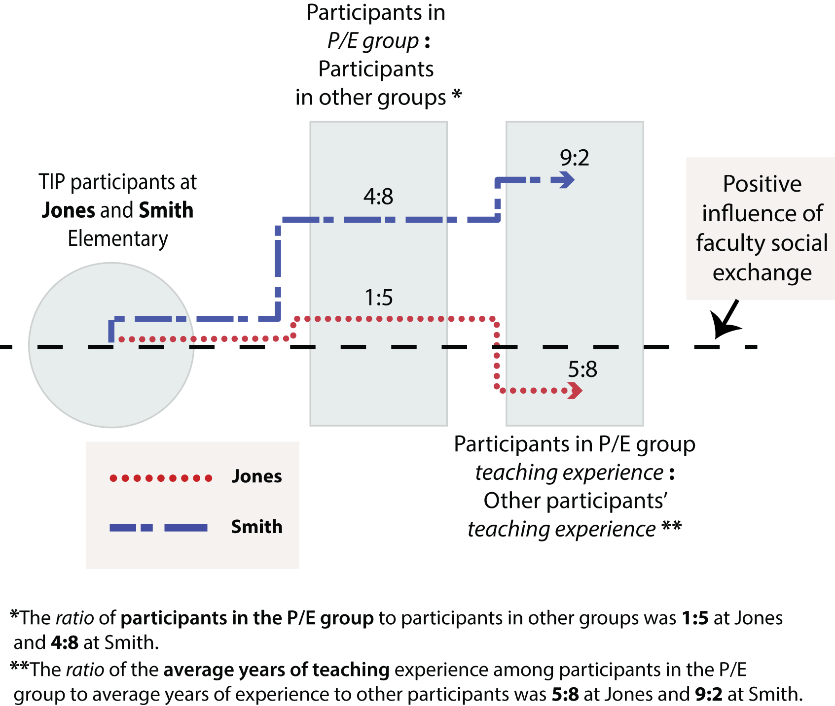
1. Credible Challengers
Notes:
Credibile challengers are teachers who challenged their colleagues’ deficit perceptions of families and were actually listened to. I found that what made a teacher feel credible to challenge her colleagues and what made teachers feel okay being challenged was the challenger’s years of experience in teaching.
Only one teacher in the P/E group and she has less teaching experience than the other teachers there.

Slide 52
“My only concern was just working here, knowing what goes on versus kind of what was said goes on, in my opinion were different, which is really nothing that you could control, nothing that [CIS coordinator] could control, and for me I’m not, that’s not something that I’m comfortable with challenging. My role at this school is, I just need to, I’m still the youngest one. I still have the least amount of experience. People don’t look to me as anyone that they need to listen to.”
-The single TIP participant in the P/E group at Jones

Slide 53
2. Principal Buy-In
Smith
Jones
Principal required certain teachers to participate
Principal scheduled TIP at the same time as a faculty meeting
Principal did not actively support the program
Notes:
Buy-in led to more teachers and a greater variety of teachers.

Slide 54
3. Interactions with broader school climate
Teachers at Smith felt comfortable being vulnerable to one another.
Admitting weaknesses
Receiving advice
Engaging in conflict
Being optimistic that colleagues could change
“I’m not alone when it comes to pre-judging parents and I have an experienced support system to answer my questions.”
–First-year Smith teacher
Notes:
Fresh Start had made teachers mistrustful of one another, teachers who had more longevity at the school felt they had the credibility to speak up

Slide 55
“It’s acceptable for adults in our building to make excuses for why the students do, act the way they do and why the parents act the way they do, and not accepting as much responsibility. So, I think that’s common, kind of, in all settings. It wasn’t just in that room. That’s a pretty common thing.”
-Jones TIP participant

Slide 56
4. CIS coordinators approached their work differently
Smith
Jones
Coordinator explained her role as building stronger relationships between teachers and families.
Coordinator explained her role as taking action to support families and teachers as individual groups.
Different personalities, past work experiences, and school climates

Slide 57
“You know, when, I think it’s easy when people get really, really frustrated and they’re tired and they’re at the end of their rope, it’s easy for teachers to backslide and say like, ‘Well, dang it, she’s just a sucky mom,’ and, you know, ‘She’s just not trying.’ And I’ve been in the middle of those conversations where one of our TIP participants was just going off on a rant and I just stood there and kept smiling and I said, ‘This is so hard for you.’ And she stopped and that was her shift. She started crying and she was like, ‘This is, because this is what we were working for, and I know that the mom can do better and I want to help her do better, and I know that the kid can do better.’ And that’s when the real stuff happened.”
-Smith CIS Coordinator

Slide 58
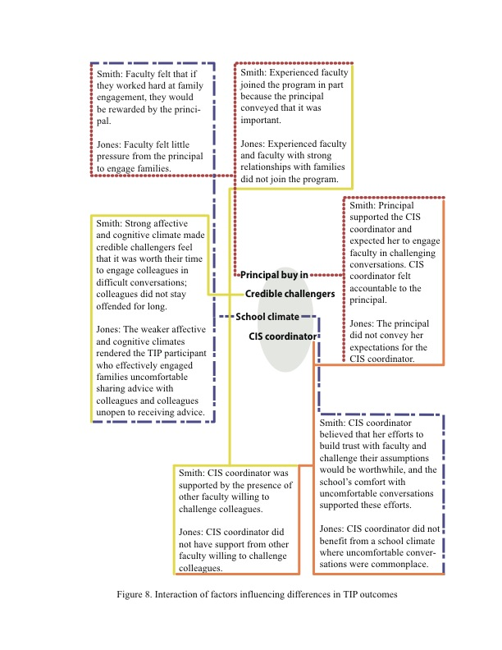

Slide 59
Discussion
Hegemonic ideas about family engagement and low-income families, difficult emotions, and pressures of the policy environment limit teacher trust in families.
Social exchange between faculty can improve collective trust in families…when faculty are willing to be vulnerable to one another.
Willingness to be vulnerable was influenced by school climate, perceived credibility of the challengers, and ongoing coaching.

Slide 60
Limitations
Role as program facilitator might have influenced participants’ honesty about TIP
Inability to interview families for a more holistic perspective
Omission of 7 classroom teachers from Webster sample
Few observations of faculty social exchange outside of TIP program
Failure of collective faculty trust scale to assess setting
Notes:
Was able to observe behavioral, cognitive, and affective mechanisms at the setting level through the TIP program, but not at the school level; asked teachers about these mechanisms, but individual opinions are different from actually observing the setting, itself

Slide 61
Implications for teacher professional development
Adapt curriculum based on school climate, particularly the extent to which teachers trust one another
Use the following items to assess trust: To what extent teachers respect other teachers who take the lead on school improvement efforts and to what extent teachers respect colleagues who are expert at their craft (Bryk et al., 2010)
Use a “cultural community wealth” framework to re-define family engagement (e.g. Yosso, 2005)
Provide training to community school coordinators (or similar roles) to help teachers cope with the emotions of family engagement
Notes:
The curriculum alone wasn’t enough to get teachers to truly change their attitudes toward families, it was only curriculum as a spark for teachers to talk with one another.

Slide 62
Implications for policy
Family engagement policies:
Incorporate family engagement skills and cultural competency into state teaching standards
Use family engagement in teacher evaluations as long as teachers are provided with support
Unless districts and schools are willing to support teachers to engage families, narratives that family engagement are important might do more harm than good
Broader educational policy:
Teacher longevity in a school builds “experience credibility.”
Hard controls make it difficult for teachers to trust one another and parents.

Slide 63
Directions for Future Research
What contextual factors impede and facilitate faculty members’ willingness to be vulnerable to one another and to parents?
More sophisticated ways to measure faculty social exchange regarding family engagement

Slide 64
Thank you!
Questions? Comments?

Slide 65




Why Trust?
1. Interdependence
2. Risk
Children do better when parents and teachers are aligned (real)
Narrative that children cannot succeed without engaged parents (perceived)
Emotional geographies (Hargreaves)
Professional stature (Lareau; Hoover-Dempsey)
Time
Notes:
Why not empathy or respect

Slide 66
Trustworthiness & Authenticity (Guba & Lincoln, 1989)
Trustworthiness
Authenticity
Prolonged engagement
Persistent observation
Peer debriefing/Member checks
Negative case analysis
Progressive subjectivity
Dependability
Confirmability
Fairness
Ontological authenticity
Educational authenticity
Tactical authenticity
Notes:
Prolonged engagement – had been working with MOBC for about a year
Observed study sessions, observed at the schools (but could have observed more)
Member checks with CIS team
Progressive subjectivity: Researchers identify and articulate any biases they hold, examine how their understandings shift during the project, and attend to how these biases might affect interpretations; my biases are as a white female, as someone who disagrees with the current educational policy environment, and as someone who supports community schools and initiatives such as PN.
Dependability - Concerned with stability over time in researchers and methods; only one researcher allowed consistency
Confirmabilty – The extent to which findings are grounded in the data; Assessed by means of reviewing research records to determine if findings can be traced to data and data to original sources. All of my coding will be easily tracked and replicable.
Fairness - Extent to which different stakeholder perspectives are elicited and taken into account; Interviewed school staff with a variety of roles; subjects/grades taught; and years of experience
Ontological authenticity - Extent to which stakeholders’ perceptions of the world have been improved or expanded
Educational authenticity - Extent to which individuals have developed a better understanding of other stakeholders’ experiences and perspectives
Tactical authenticity - Extent to which stakeholders feel empowered by the evaluation and by the ability to influence the actions taken.

